Slide 1
COVID 19 – Bed Occupancy Model
Jeyaraman Ramalingam

Slide 2
Problem Statement
With the Onset of COVID 19 Pandemic , It is essential for a hospital to estimate when the maximum bed occupancy will be reached. This could be impacted by several parameters like below.
1. Number of Admissions per day
2. Number of Recoveries per day
3. Total Number of Beds available

Slide 3
Significance of Model
Maximum bed occupancy can be calculated by running simulation keeping all the above factors as variables for n days.
We can adjust the timelines (number of days to run simulation) based on the requirements.
The model is built to accept the following Input Parameters and Output Parameters
Inputs to the Model :
1. Minimum and Maximum Number of Admissions per day - This defines a range of admissions of patients into hospital including both COVID and NON COVID patients.
2. Minimum and Maximum Number of Discharges per day - This defines a range of patients who are discharged from hospital including both COVID and NON COVID patients.
3. Number of days - This defines number of days the results need to be simulated
4. Number of Available Beds - This input marks baseline number of beds available for COVID and NON COVID patients.
Outputs from the Model :
1. Total Free Beds for COVID and NON COVID
2. Cumulative Number of COVID and NON COVID patients

Slide 4
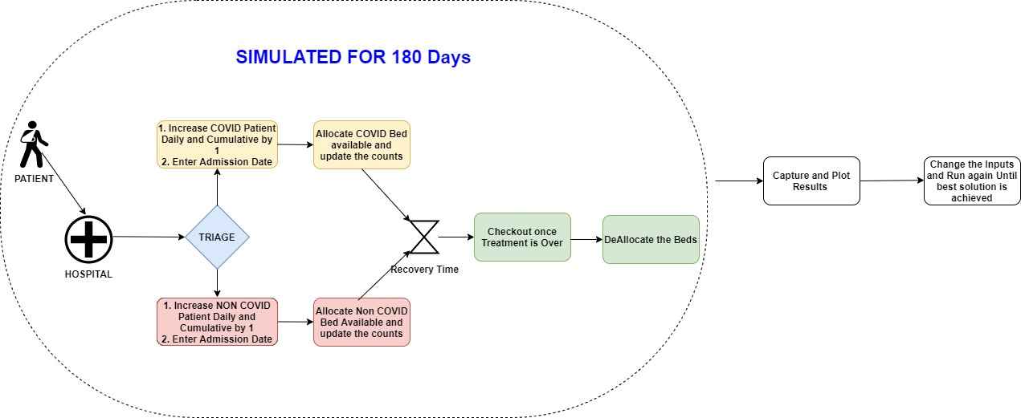
Flow Chart

Slide 5
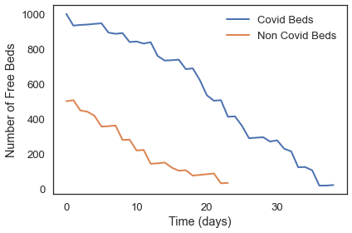
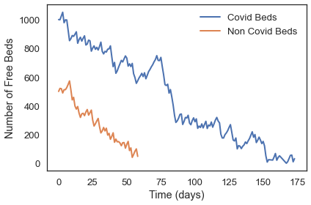
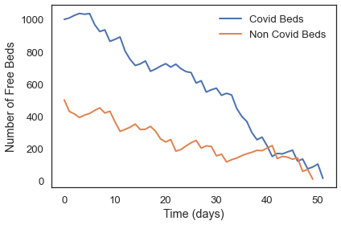
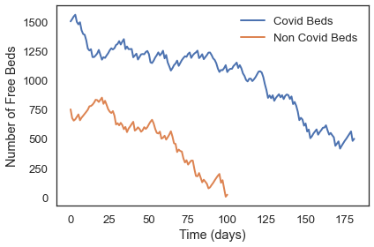
Analysis by varying Model Inputs

Slide 6
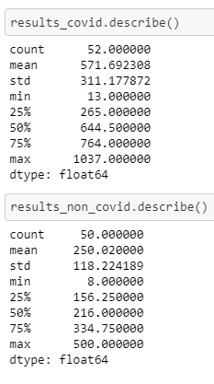
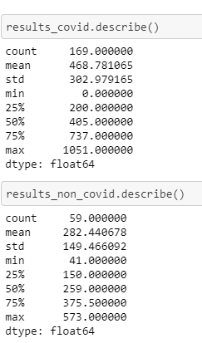
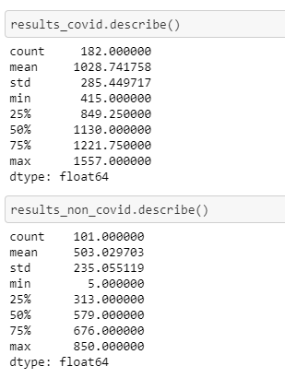
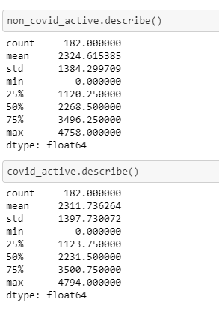
Metrics – Max Beds Needed Vs Case Count

Slide 7
Conclusion
Bed Occupancy saturation is improved by holding the discharge rate around 50% and by increasing the Bed count.
We can run simulation by varying all the other parameters and let the hospital management take better decision to make sure the sufficient number of beds available for the patients.

